Slide 1
SENTHILKUMAR S
WEB DESIGNER

Slide 2
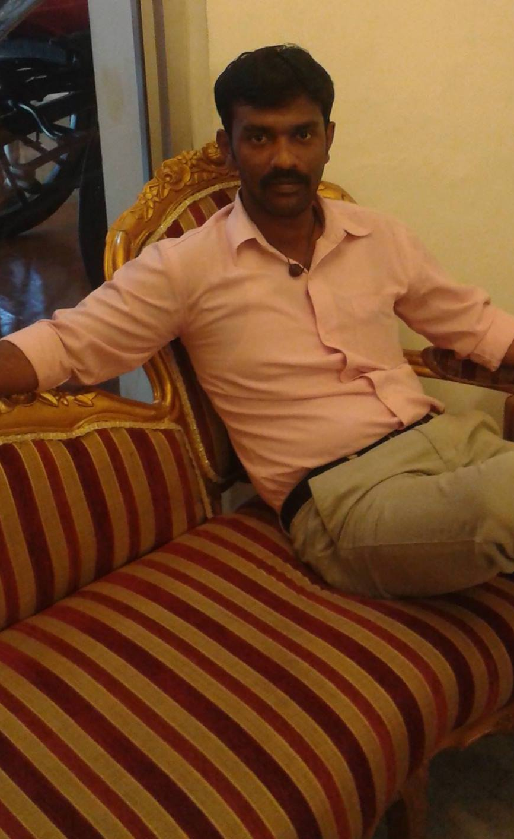
SAMPLE PROJECTS

Slide 3









TECHNOLOGY USED

